Slide 1

Project 3 online Tech Sales
Ingrid Camacho, Jennifer Ilyayeva, Dhanielle Bermudez ​

Slide 2
Project Scope and methodology

Slide 3
Objective
The purpose of this project is to analyze potential trends in sales outcomes by examining detailed consumer behavior and spending patterns within a dataset from 2023. Our goal is to uncover insights into several key aspects of sales, including:
Spending Trends: Identifying whether consumers are actively spending and the overall direction of sales momentum.
Categories of Interest: Understanding which product categories are driving the most consumer engagement and revenue.
Monetary Insights: Analyzing the average and total amounts consumers are spending across different segments.
Geographic Preferences: Exploring regional or location-based differences in purchasing habits.
Brand and Product Popularity: Highlighting which specific products or brands are resonating most with consumers.
Consumerism Patterns: Examining broader consumer behavior to determine how economic and social factors might be influencing purchasing decisions.
By diving into this data, we aim to provide actionable insights into what drives consumer purchases, the brands or products capturing the market’s attention, and how these trends might shape future sales strategies.

Slide 4
Hypothesis
We hypothesize that Apple will lead in sales across 2023, consistently outperforming competitors across all demographics; genders, locations, and income levels, driven by its unparalleled product popularity and strong brand loyalty. While the creator economy is heavily influenced by female creators, we anticipate a significant shift in sales toward male consumers. This trend aligns with the dominance of males in IT and tech-driven fields, where Apple products are often preferred for their functionality and ecosystem integration. This dual influence of brand loyalty and industry trends positions Apple as a key player across diverse consumer segments.

Slide 5
Tech Requirements
Total Sales
Tech Sales
Insights

Slide 6
Tech Requirements
Total Sales
Tech Sales
Insights

Slide 7

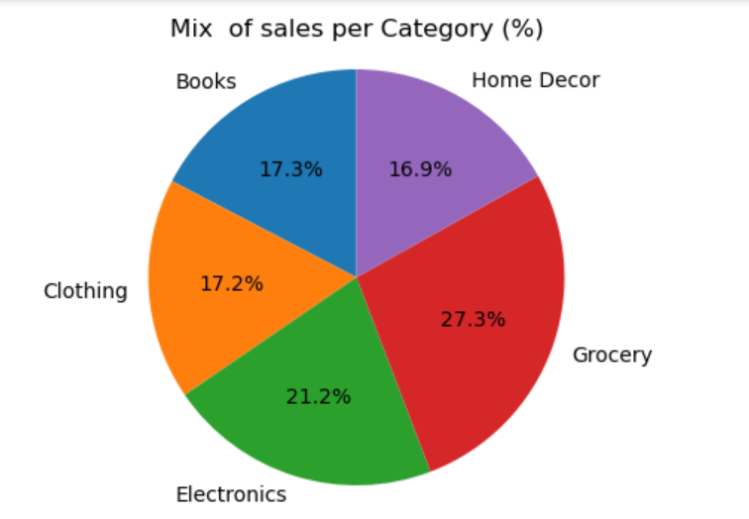


Total Sales 2023 $105MM Groceries and tech the largest categories of sales

Slide 8
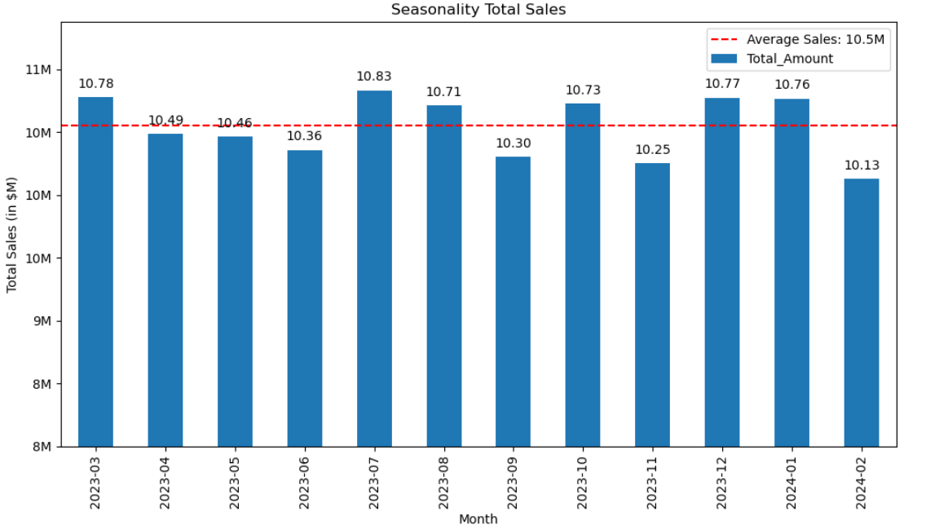
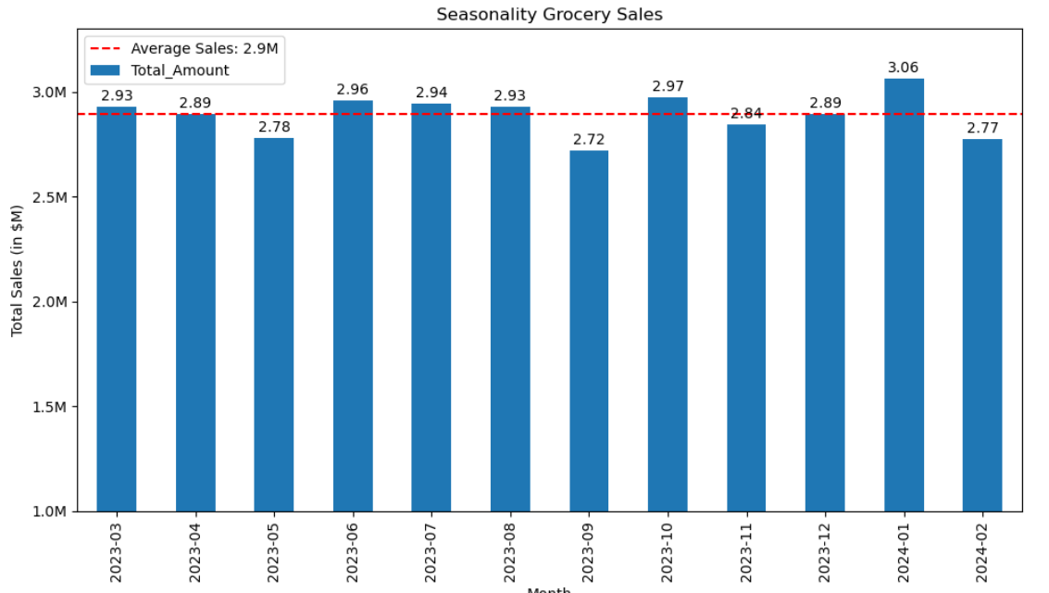
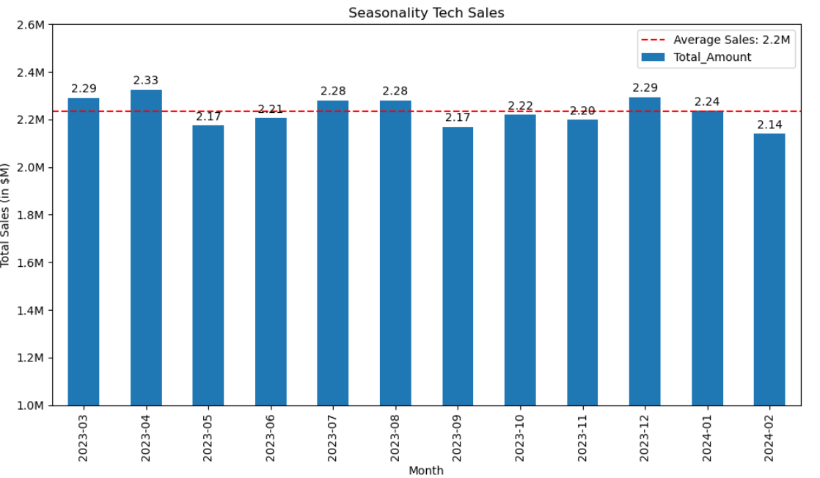
Total Sales 2023 $105M Average of $10.5M sales per month, highest sales in July Lowest December
Grocery Sales are higher in January and lowest in September, while tech sales are higher in December and Back to School(Aug)
Total Sales are higher in the Summer and Year end, while decline in February

Slide 9
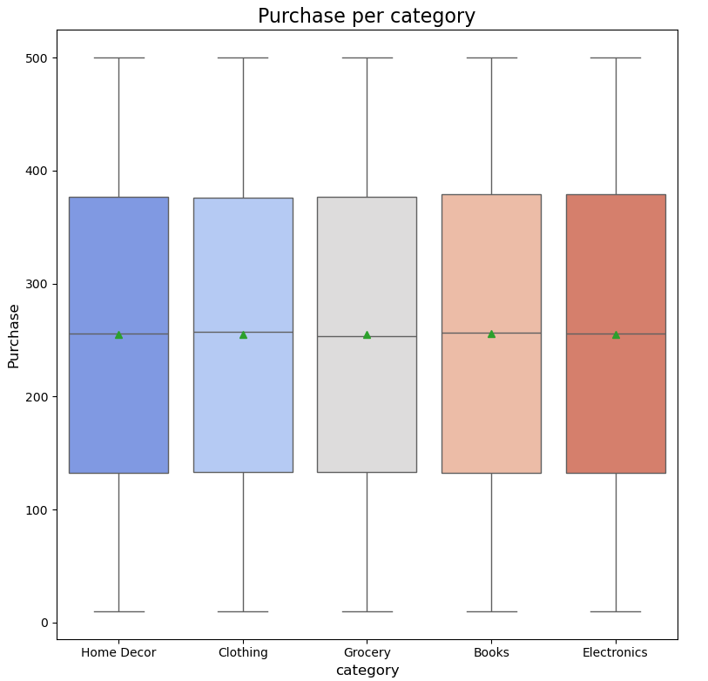
Total Sales 2023 $105M purchases amount is very similar between categories

Slide 10
Tech Requirements
Total Sales
Tech Sales
Insights

Slide 11
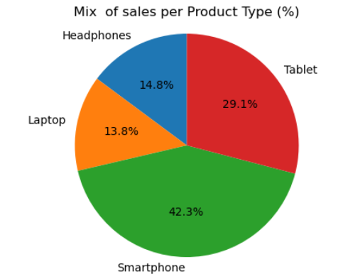
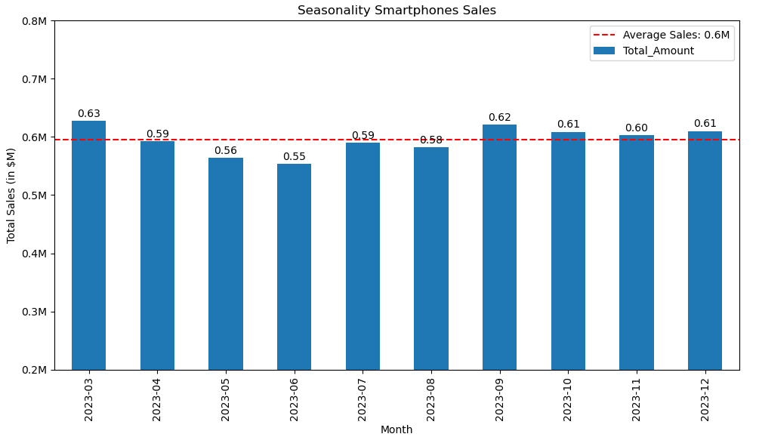
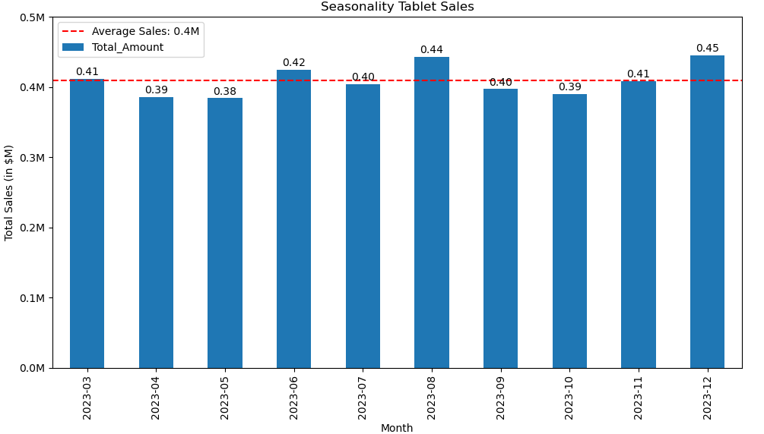
Total Tech Sales 2023 $14MM* smartphone, Tablets are the two products of higher sales
Largest category is Smartphone, followed by tables
Smartphones are higher in December and tablets over the Back to School
* Excludes Fridges, TV and AC

Slide 12
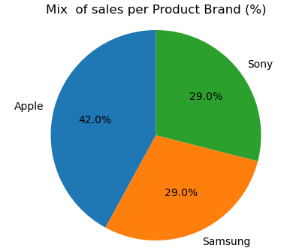
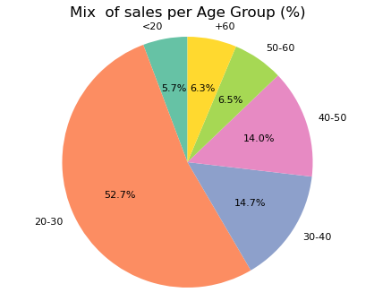
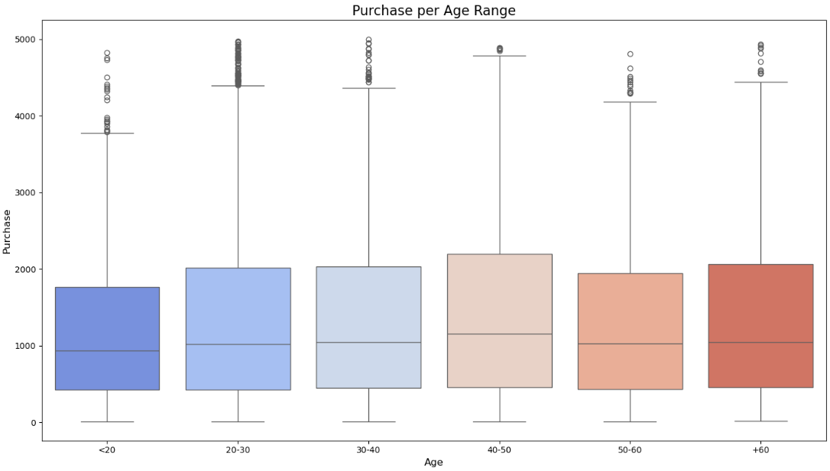
Total Tech Sales 2023 split of sales
Apple leading brand in the tech sales in value and transactions, Sony and Samsung with similar share
Largest sales in the Age group between 20-30
followed by 30-40yrs
Total purchased amount is larger in average for
40- 50years group, larges dispersion of sales in the 20-30 yrs group
Purchases decline in value after 50 yrs
* Excludes Fridges, TV and AC

Slide 13
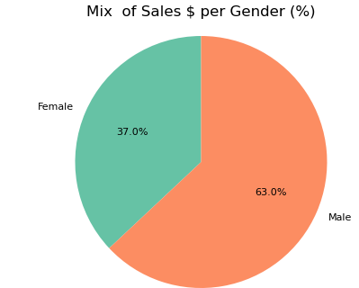
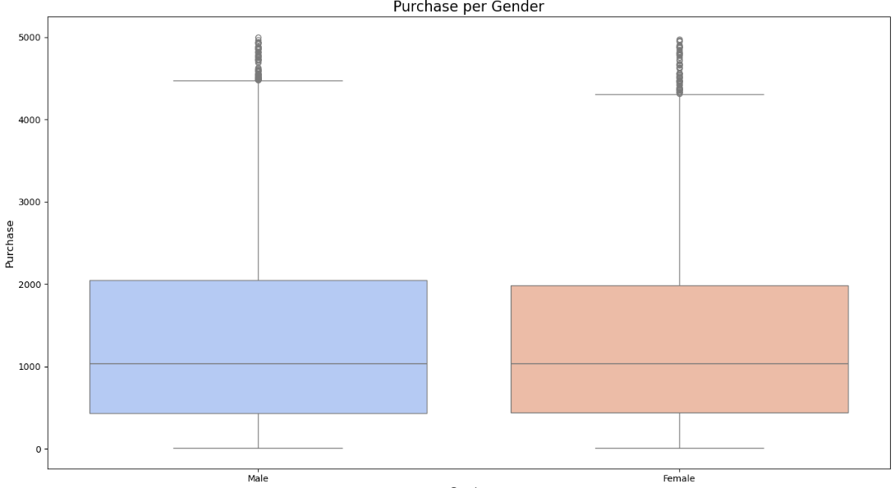
Total Tech Sales 2023 Great opportunity to increase focus on woman, the sales are lower in % but in value are around the same
Women still under 50% of sales, could imply an opportunity given the increase in purchasing power of women
Women total amount purchased per transaction is very similar to men’s
* Excludes Fridges, TV and AC

Slide 14
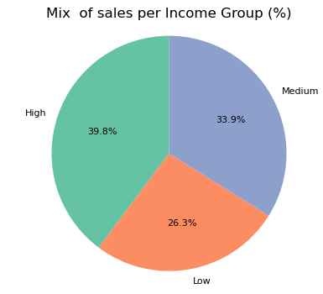
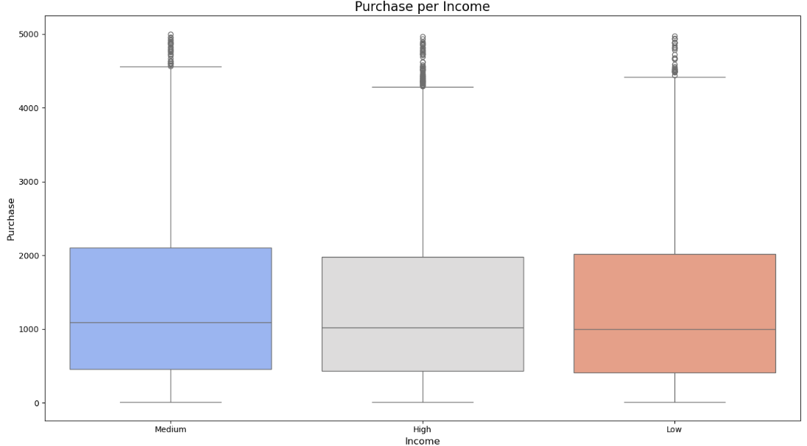
Total Tech Sales 2023 CONTINUE TO ADVERTISE HIGH PRICE ITEMS TO HIGH INCOME, WHILE AN OPPORTUNITY TO DEVELOP LOWER PRICING ITEMS FOR AFFORDABILITY
High income group consumes almost 40% of total sales
However, average is slightly below the medium income group, with high deviations, continues to be a target for sales of high value items
* Excludes Fridges, TV and AC

Slide 15
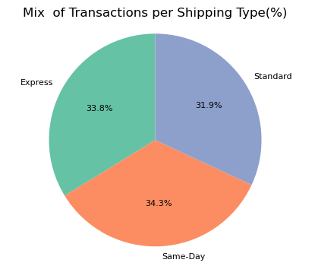
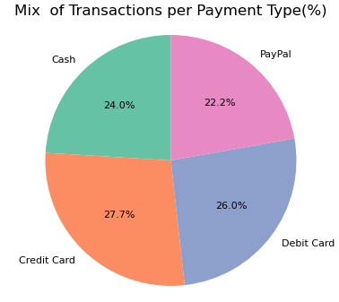
Total Tech Sales 2023 DIVERSE OFFERINGS IN SHIPPING AND PAYMENTS CONTINUE TO BE KEY TO MAINTAIN SALES
* Excludes Fridges, TV and AC

Slide 16
Tech Requirements
Total Sales
Tech Sales
Insights

Slide 17
Total Tech Sales 2023 $MM* Correlations
* Excludes Fridges, TV and AC

Slide 18
Total Tech Sales 2023 $MM* MAPs
* Excludes Fridges, TV and AC

Slide 19
Our web page MAPs
* Excludes Fridges, TV and AC

Slide 20

Thank You

